Slide 1

Four Week Team Project Plan
Wezley Singleton, Joseph Freese, raphael Fonseca
And Christopher jackson

Slide 2
What is Required of Theater Seating Program?
Display’s a screen that shows which seats are available when taken
Display must show
12 rows of seats
10 seats in each row
# will represent available seats and * will show taken
Function that allows user to purchase tickets
User should be able to choose if they would like to see a list of seats sold

Slide 3
Some additions the team would like to see.
Menu Function
Show prices
Purchase tickets
Function that allows the user to loop back to menu to purchase more tickets or exit the program
Function that checks to see if the user is certain they are satisfied of final price.
Show how much specific seats are
$15 normal
$17 comfort(front rows)

Slide 4
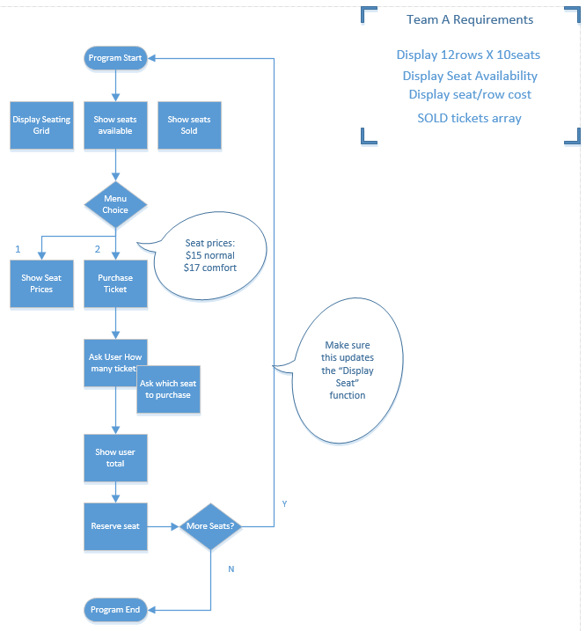
Flow Chart of Program(Alpha)

Slide 5
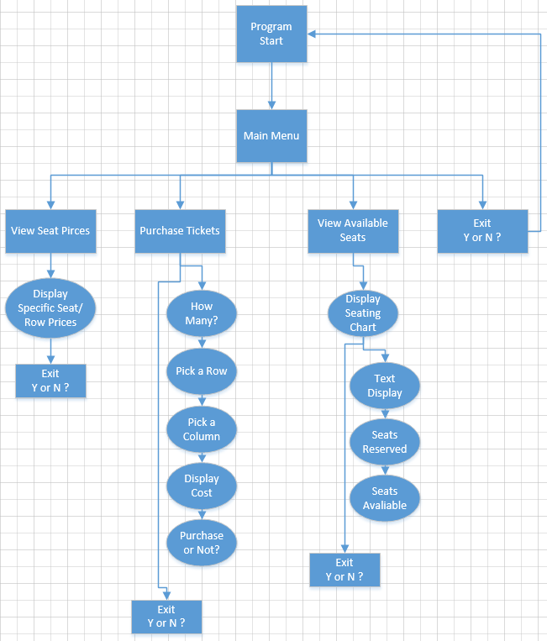
Updated FlowChart(W5 Final)
This is the updated Flowchart to show the teams progression in the last week

Slide 6
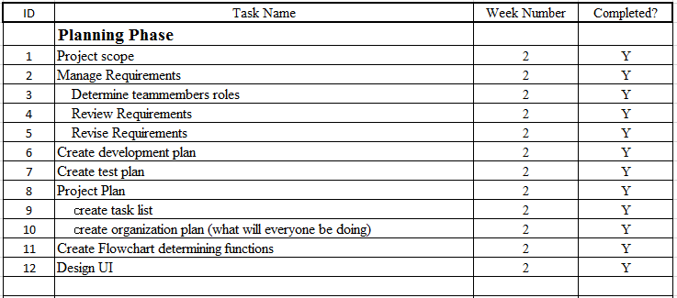
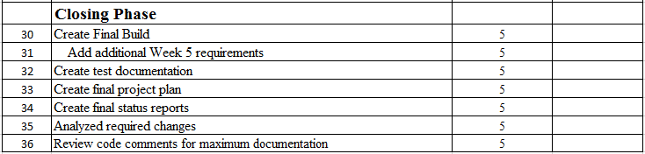
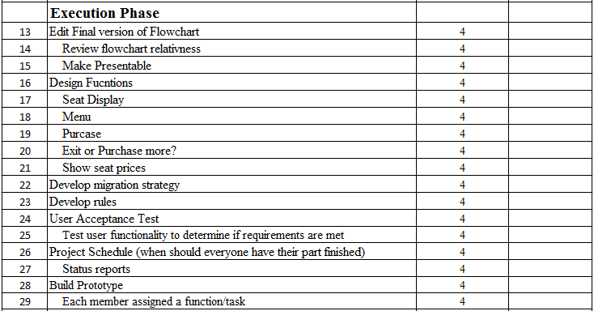
Project Plan Template

Slide 7
Final Changes
Arrays/loops/switch added:
Array for purchases
Switch statement for main menu
Changed continueAsk to a switch statment
Function:
continueAsk will ask if the user would like to return to main menu or exit.
Purchase ticket include while loop
Fixed Purchase array to properly interact with other functions
Added Features:
When asking if user wants to Exit or go to main, the console clears.
Seating is now displayed within function rather than in the beginning in the

